Slide 1
Monitoring the Status of MPLS VPN and VPLS Based on BGP Signaling Information
Giuseppe Di Battista
Massimo Rimondini
Giorgio Sadolfo
IEEE/IFIP NOMS 2012
18/04/2012

Slide 2
Monitoring the Status of MPLS VPN and VPLS Based on BGP Signaling Information
About MPLS VPNs/VPLS
MPLS
VPN
VPLS
Giuseppe Di Battista
Massimo Rimondini
Giorgio Sadolfo
IEEE/IFIP NOMS 2012
18/04/2012

Slide 3
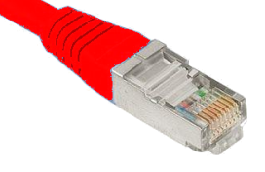
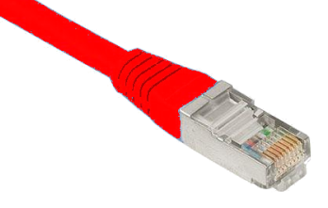
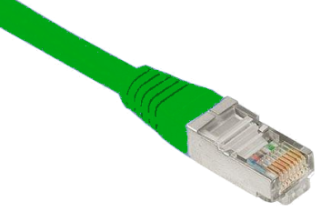
About MPLS VPNs/VPLS
Customer
site
Customer
Customer
site
CE
CE
PE
Customer
site
PE
ISP BB
’s EtherSphere™
CE
PE
PE
PE
CE
Customer
CE
Customer
site
Customer
site

Slide 4
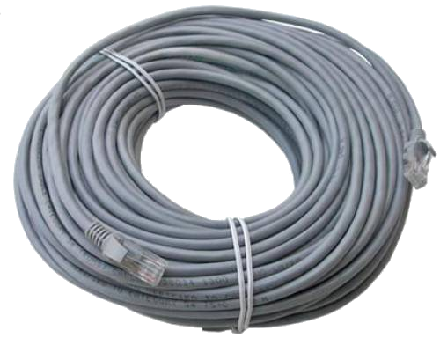
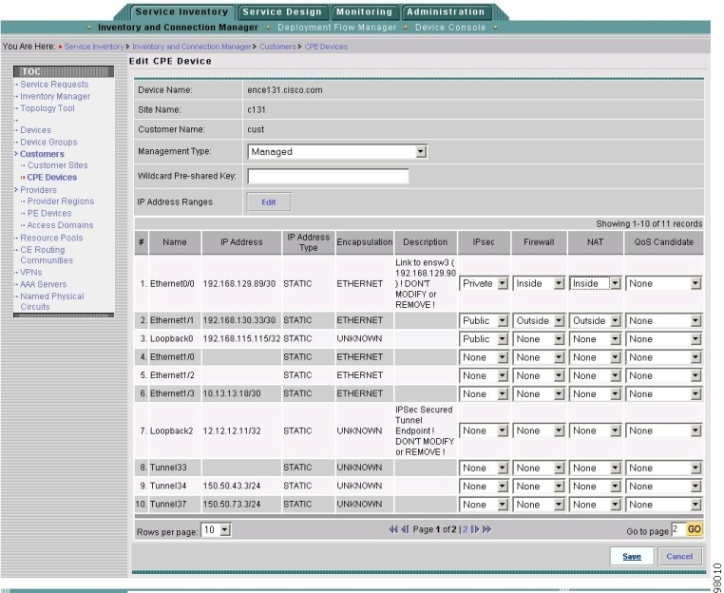
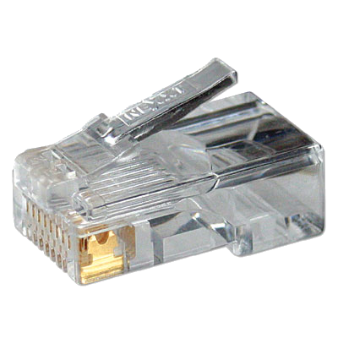
About MPLS VPNs/VPLS
192.168.0.4
Notes:
No need to lay/rearrange cables
Little configuration effort

Slide 5
State of the Art (in MPLS/VPLS monitoring)
industry
research
MPLS and VPLS
industry
research
control plane
monitoring
technology

Slide 6
State of the Art (in MPLS/VPLS monitoring)
 | IP Solution Center
 | Service Aware Manager
 | Service Activator Solution for VPN Services
 | Tivoli Network Manager
 | VPN Explorer
industry
research
technology

Slide 7
State of the Art (in MPLS/VPLS monitoring)
Routing convergence
D. Pei, J. Van der Merwe. BGP Convergence in Virtual Private Networks. Proc. IMC, 2006.
Scalability
C. Kim, A. Gerber, C. Lund, D. Pei, S. Sen. Scalable VPN Routing via Relaying. Proc. SIGMETRICS, 2008.
Monitoring
M. K. Thottan, G. K. Swanson, M. Cancone, T. K. Ho, J. Ren, S. Paul. SEQUIN: An SNMP-based MPLS Network Monitoring System. Bell Labs Technical Journal 8(1), 95–111, 2003.
industry
research
technology

Slide 8
State of the Art (in MPLS/VPLS monitoring)
SNMP
TIBCO Rendezvous Message Transport
Oracle DBMS
RCP, RSH
Telnet, SSH
TFTP, FTP
industry
research
technology
Notes:
http://publib.boulder.ibm.com/infocenter/tivihelp/v8r1/topic/com.ibm.networkmanagerip.doc_3.9/itnm/ip/wip/resolve/task/nmip_ops_retrievevplsinfo.html?resultof=%22%76%70%6c%73%22%20

Slide 9
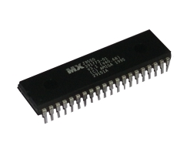
Our Contributions
MPLS VPN/VPLS monitoring methodology
Focus on monitoring
Observation of effects of network events
Reconfigurations
Failures
Additional technologies required
Requires access to devices
Graphical visualization of VPN states
Extensive discussion on scalability vs visibility of (the effects of) network events
Architecture, prototype, experimentation in Junosphere
+ provisioning
Observation of the network status
Exhaustive analysis of observable effects
Instant snapshot of device states
(Almost)
+ history
Standard technologies (BGP)
Unobtrusive
Discovery of a subtle anomaly in the routing software, confirmed by Juniper
Notes:
We believe that state-of-the-art solutions fall short in a few aspects that we address in our contribution

Slide 10
Methodology
1
Collect signaling messages
2
Reconstruct visibility of VPNs at PEs
3
Visualize VPN states
Notes:
The methodology is meant to complement existing approaches, not to replace them

Slide 11
Methodology 1. Collection
Approach | Drawback(s)
Monitor network traffic | Undetermined in absence of traffic
Inject network traffic | Intrusive; hard to tune
Watch router configurations | Intrusive; access restrictions may apply
Watch router states | Same as above + untimely
Notifications (e.g., SNMP) | Additional technologies required
* | Limited visibility of the effect of a configuration
Monitor signaling messages | N/A
LDP
BGP
Actual propagation of information
Routing decisions @ PEs

Slide 12
Methodology 1. Collection
VPN signaling
MPLS: BGP
VPLS:
 | Autodiscovery | Signaling | Vendor
RFC 4762 (Kompella) | N/A | LDP | Cisco
RFC 4761 | BGP | BGP | Juniper
BGP-based VPLS Autodiscovery
LDP-BGP VPLS Interworking
BGP is also...
easy to set up
scalable
policy-aware

Slide 13
Methodology 1. Collection
BGP peerings
Customer
site
Customer
site
CE
CE
PE
Customer
site
PE
CE
RC
PE
PE
PE
Mmmh... I’m a reflector-client
CE
CE
Customer
site
Customer
site

Slide 14
Methodology 2. Reconstruction of VPN state
type (A/W)
timestamp
RD
+
prefix
NLRI
NLRI
NLRI
CE ID
BGP update
Extended communities
Extended communities
Extended communities
RT
Exhaustive comparison of information from different BGP updates

Slide 15
Methodology 2. Reconstruction of VPN state
Example
RD₁
RT₂
RD₁
pfx₁
+
pfx₁
RT₁
+
PE₁
Changed VPN?
Reconfiguration?
Policy change?
Moved pfx₁ to a different VPN?
A
RD₁
+
pfx₁
RT₂

Slide 16
Methodology 2. Reconstruction of VPN state
Apply the method to a sequence of BGP updates
Reconstruct history of VPN visibility at each PE
...

Slide 17
Methodology 2. Reconstruction of VPN state
A few difficulties:
Investigation of the PE where the effect was first observed
Dealing with missing attributes in withdrawals
Inadmissible announcements [rfc4761]
Reannouncements
Synchronization with actual VPN states
Monitoring RC peering states
Notes:
The first point can be addressed by looking at the originator ID
Reannouncements may happen, e.g., when just changing the local preference

Slide 18
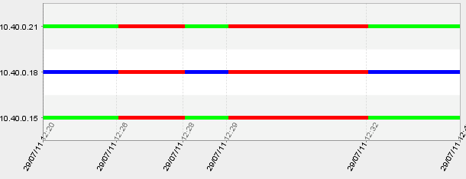
Methodology 3. Visualization
Query: visibility at each PE of
RD 12345:10011
prefix 172.16.110.0/30
RT 12345:111
visible
originated
not visible
PE
time
BGP updates

Slide 19
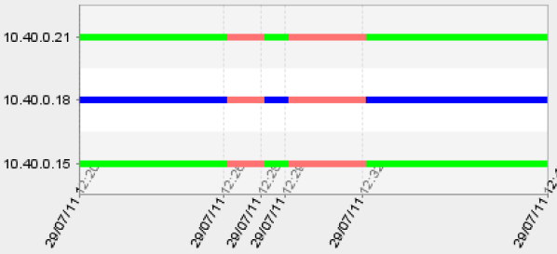
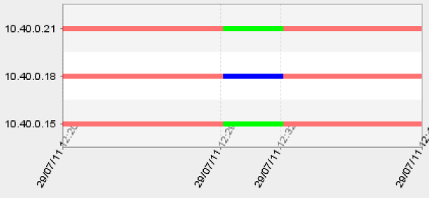
Query: visibility at each PE of
RD 12345:10011
prefix 172.16.110.0/30
...with RT
12345:111
...with RT
12345:222

Slide 20
Methodology 3. Visualization
Queries
Check information propagation
Input: RD+{prefix,CE ID}, RT
Output: Visibility from all PEs
Check a PE’s visibility of a specific VPN
Input: RT, PE
Output: Visibility of all RD+{prefix,CE ID} with that RT at that PE
Highlight belonging of a prefix to a VPN
Input: RD+{prefix,CE ID}
Output: Visibility of that RD+{prefix,CE ID} from all PEs, with each seen RT
Highlight participation of PEs in VPNs
Input: RT
Output: Visibility of that RT at each PE
* VPN≡RT
# over time
#
*
#
*
#
*
#

Slide 21
Scalability
Routing table size
>> #Internet prefixes: ~ k × 10⁵ [Ben-Houidi et al. 07]
Only routing updates count
Same scalability of [ORV], [BGPlay], [iBGPlay]
Amount of routing updates
Lots of customers, prefixes, VPNs, etc.
Bursts (due to, e.g., configurations changes, faults) are unlikely
2-3 orders of magnitude less than VPN routes [Ben-Houidi et al. 07]
Our prototype works even for M/L ISPs
[Ben-Houidi et al. 07] Z. Ben-Houidi, R. Teixeira, and M. Capelle, “Origin of route explosion in virtual private networks,” in Proc. CoNEXT, 2007.

Slide 22
Scalability vs Visibility
RC
PE1
PE4
PE2
PE3
CE
CE
Customer
site
Customer
site

Slide 23
Scalability vs Visibility
RC
RR
PE1
PE4
PE2
PE3
CE
CE
Customer
site
Customer
site

Slide 24
Scalability vs Visibility
RC
RR
PE1
PE4
PE2
PE3
CE
CE
Customer
site
Customer
site

Slide 25
Scalability vs Visibility
RC
RR
PE
layer
RR
PE
lower
RR
higher
RR
PE
PE
scalability
lower
higher
PE
PE
PE
PE
PE
visibility
PE
better
worse
beware of matching updates

Slide 26
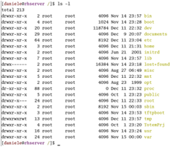
Experimental Scenario
libbgpdump
bash
PE
+
+
max lag: 3mins
advertise MP extensions for L2VPN
dump relevant fields to MRT
local storage
process L2VPN MP from MRTs
routing
daemon
route retriever
route collector
preliminary tests
on Cisco routers
JFreeChart
database
visualization client
Notes:
split horizon: a PE MUST NOT forward traffic from one PW to another in the same VPLS mesh

Slide 27
SEA
CE
CE
CHI
CE
PE
PE
NYC
RR
RR
PE
DEN
RC
RR
TR
RR
TR
LAX
TR
TR
RR
TR
WAS
ATL
RR
PE
PE
HOU
RR
PE
RR
PE
CE
CE
PE
CE
CE
CE

Slide 28
SEA
CE
CE
CHI
CE
PE
PE
NYC
RR
RR
PE
DEN
RC
RR
MPLS
RR
VPLS
LAX
RR
WAS
ATL
RR
PE
PE
HOU
RR
PE
RR
PE
CE
CE
PE
CE
CE
CE

Slide 29
SEA
CE
CE
CHI
CE
PE
PE
NYC
RR
RR
PE
DEN
RC
RR
RR
LAX
RR
WAS
ATL
RR
PE
PE
HOU
RR
PE
RR
PE
CE
CE
PE
CE
CE
CE

Slide 30
SEA
CE
CE
CHI
CE
PE
PE
NYC
RR
RR
PE
DEN
RC
RR
RR
LAX
RR
WAS
ATL
RR
PE
PE
RR
HOU
PE
RR
PE
CE
CE
PE
CE
CE
CE

Slide 31
Experiments
Injected events:
(De+re)activation of customer sites
RT change
(De+re)activation of multihoming
Local preference change in a multihoming configuration
Timing
Random order
Varying rate ( [1/hr...100/min] )
> 150,000 collected BGP updates
Processing time: < 20s, without optimizations

Slide 32
SEA
CE
CE
CHI
CE
PE
PE
NYC
RR
RR
PE
DEN
RC
RR
RR
VPLS only!
LAX
RR
WAS
ATL
RR
PE
PE
RR
HOU
PE
RR
PE
CE
CE
PE
CE
CE
CE
Notes:
No STP, split-horizon (a PE MUST NOT forward traffic from one PW to another in the same VPLS mesh)

Slide 33
The Oscillation Problem
Did not affect forwarding
Investigation with Juniper
Best route selection in VPLS only considered
VPLS control flags
site preference
PE router ID
ties were broken on most recent announcement (could carry updated labels)
Disagree [Griffin et al. 02]
Fix (being) released
[Griffin et al. 02] T. Griffin, F. B. Shepherd, and G. Wilfong, “The stable paths problem and interdomain routing,” IEEE/ACM Transactions on Networking, vol. 10, no. 2, pp. 232–243, 2002.
Notes:
Disagree?

Slide 34
Wrapping Up
A monitoring methodology
Discussion on scalability vs visibility
Architecture & prototype implementation
Experimentation revealing routing anomaly
Effects
Signaling
MPLS+VPLS
Visualization
Operation
Reconfiguration
Troubleshooting

Slide 35
Future Work/Open Problems
Monitor other protocols/kinds of information
Collect non-best routes
Improve the visualization
Trigger alarms
Improve inference of event causes

Slide 36
Acknowledgments to
Thank you

